Slide 1
Database Design and Implementation
Lecture 2
Entity Relationship Modeling

Slide 2
Agenda
This topic will cover:
  Attributes
  Entity Relationship Model
  Relationships
  Relationship Degree
  Specialization and Generalization
  Primary Keys
Notes:
NCC Education - Slide Master

Slide 3
Attributes
Characteristics of entities
Required attribute: Must have a value, cannot be left empty
Optional attribute: Does not require a value, can be left empty
Domain - Set of possible values for a given attribute
Identifiers: One or more attributes that uniquely identify each entity instance

Slide 4
Entity Relationship Model (ERM)
ER depicts the:
  Conceptual database as viewed by end user
  Database’s main components
    Entities
    Attributes
    Relationships

Slide 5
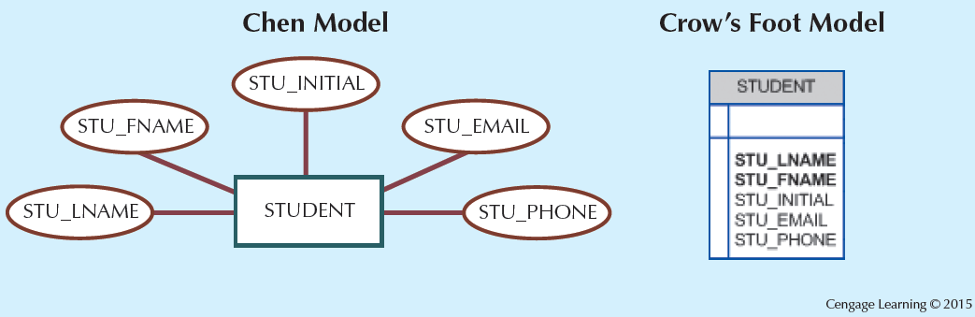
Figure - The Attributes of the Student Entity: Chen and Crow’s Foot

Slide 6
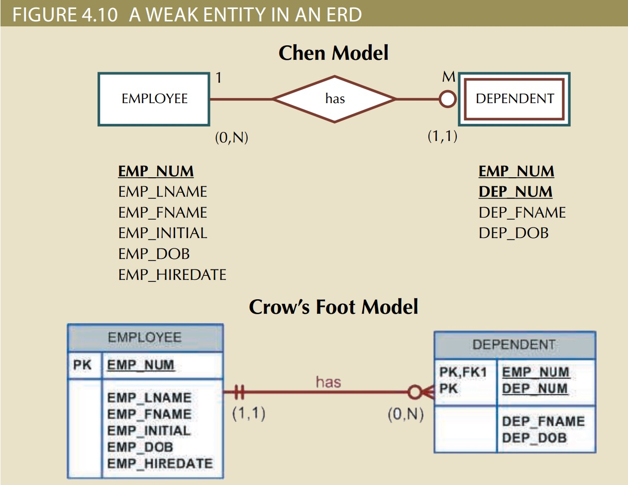

Slide 7
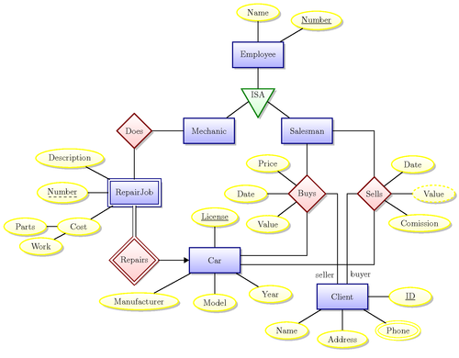

Slide 8
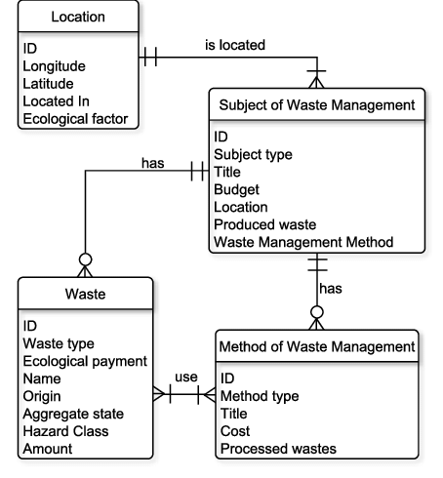

Slide 9
Attributes
Identifier attribute: Primary key and foreign keys
Composite attribute: Attribute that can be subdivided to yield additional attributes
Simple attribute: Attribute that cannot be subdivided
Single-valued attribute: Attribute that has only a single value
Multivalued attributes: Attributes that have many values

Slide 10
Attributes
Multivalued attributes: Attributes that have many values and require creating:
  Several new attributes, one for each component of the original multivalued attribute
  A new entity composed of the original multivalued attribute’s components
Derived attribute: Attribute whose value is calculated from other attributes
  Derived using an algorithm

Slide 11
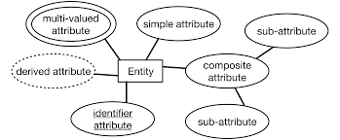

Slide 12
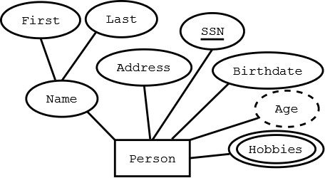

Slide 13
Relationships
Association between entities that always operate in both directions
Participants: Entities that participate in a relationship
Connectivity: Describes the relationship connection
Cardinality: Expresses the minimum and maximum number of entity occurrences associated with one occurrence of related entity

Slide 14
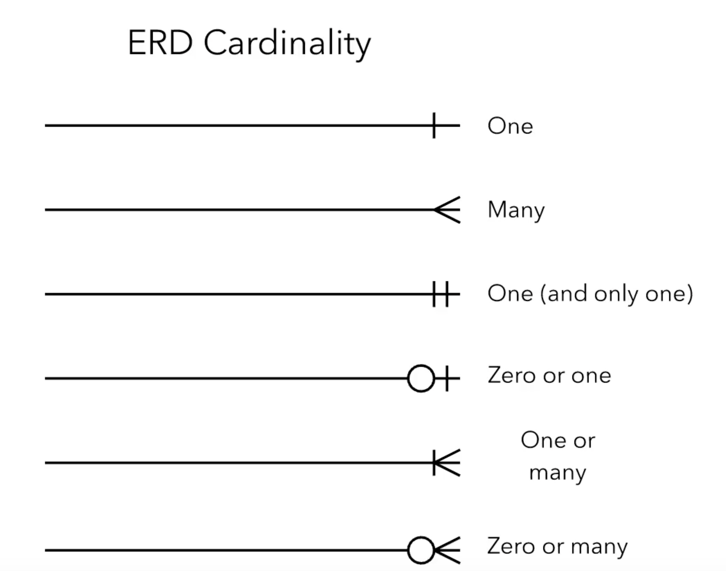

Slide 15
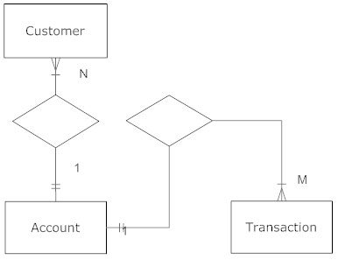

Slide 16
Existence Dependence
Existence dependence
Entity exists in the database only when it is associated with another related entity occurrence (weak entity)
Existence independence
Entity exists apart from all of its related entities
Referred to as a strong entity or regular entity

Slide 17
Weak Entity
Conditions
  Existence-dependent
  Has a primary key that is partially or totally derived from parent entity in the relationship
Database designer determines whether an entity is weak based on business rules
For example: Is it necessary for a bank customer to take loan?

Slide 18
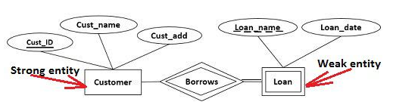

Slide 19
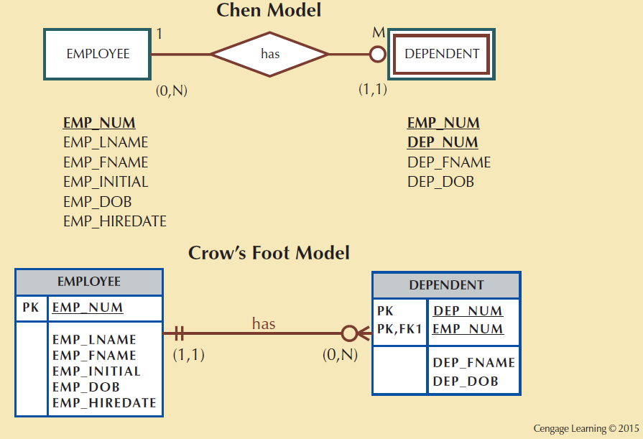
Figure - A Weak Entity in an ERD

Slide 20
Relationship Participation
Optional participation
One entity occurrence does not require a corresponding entity occurrence in a particular relationship
Mandatory participation
One entity occurrence requires a corresponding entity occurrence in a particular relationship

Slide 21
Relationship Degree
Indicates the number of entities or participants associated with a relationship
Unary relationship: Association is maintained within a single entity
  Recursive relationship: Relationship exists between occurrences of the same entity set
Binary relationship: Two entities are associated
Ternary relationship: Three entities are associated

Slide 22
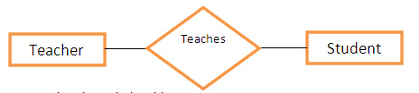
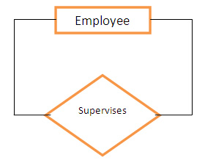
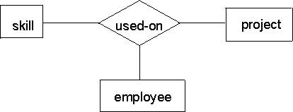
Figure - Three Types of Relationship Degree

Slide 23
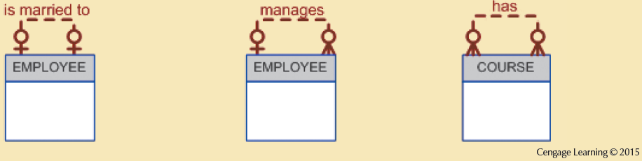
Figure - An ER Representation of Recursive Relationships

Slide 24
Associative Entities
Also known as composite or bridge entities
Used to represent an M:N relationship between two or more entities
Is in a 1:M relationship with the parent entities
  Composed of the primary key attributes of each parent entity
May also contain additional attributes that play no role in connective process
Suppose you have a call center, and you need to track the occurrences of phone calls between Customers and Employees. There is a Many-To-Many relationship between the Customer and Employees entities because each Customer can have many phone calls with Employees, and each Employee can have many phone calls with Customers.
Suppose you call this Associative Entity table, EmployeeCustomerCalls. Each row in the table will represent one phone call that occurred between an Employee and a Customer. Therefore, you will need to store the EmployeeID and the CustomerID in the table

Slide 25
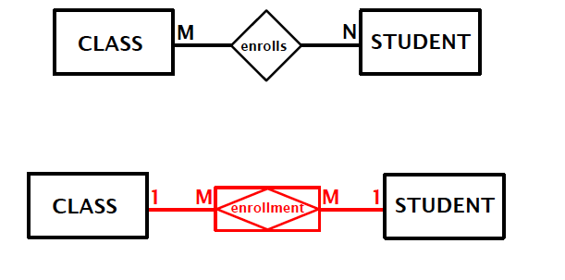

Slide 26
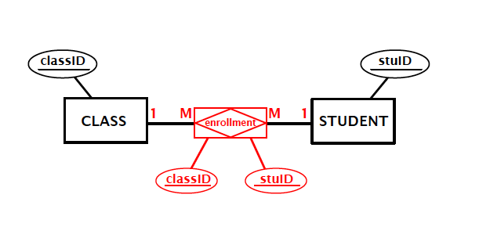
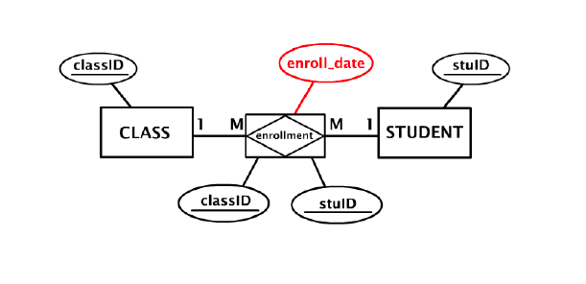

Slide 27
Developing an ER Diagram
Create a detailed narrative of the organization’s description of operations
Identify main entities and relationships from the business rules
Develop the initial ERD
Identify the attributes and primary keys that adequately describe entities
Revise and review ERD

Slide 28
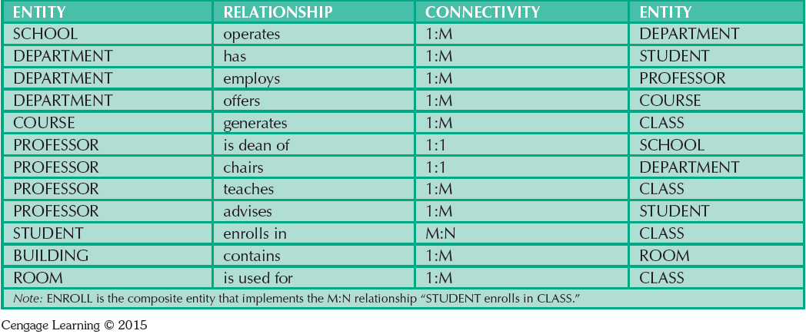
Components of the ERM

Slide 29
Entity Supertypes and Subtypes
Entity supertype: Generic entity type related to one or more entity subtypes
  Contains common characteristics
Entity subtype: Contains unique characteristics of each entity subtype

Slide 30
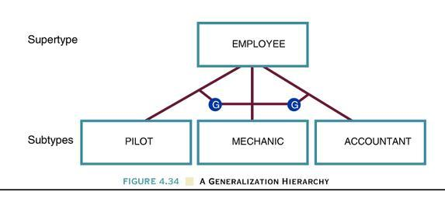

Slide 31
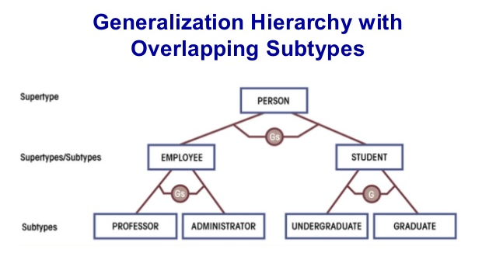

Slide 32
Specialization Hierarchy
Depicts arrangement of higher-level entity supertypes and lower-level entity subtypes
Relationships are described in terms of “is-a” relationships

Slide 33
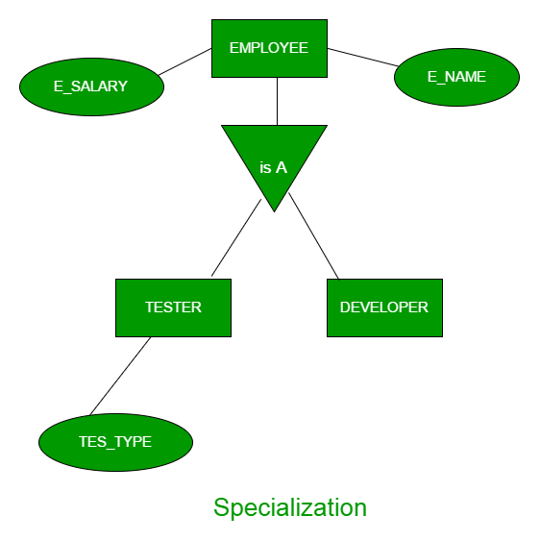

Slide 34
Inheritance
Enables an entity subtype to inherit attributes and relationships of the supertype
All entity subtypes inherit their primary key attribute from their supertype
At the implementation level, supertype and its subtype(s) maintain a 1:1 relationship
Entity subtypes inherit all relationships in which supertype entity participates
Lower-level subtypes inherit all attributes and relationships from its upper-level supertypes

Slide 35
Specialization and Generalization
Specialization
Generalization
  Top-down process
  Identifies lower-level, more specific entity subtypes from a higher-level entity supertype
  Based on grouping unique characteristics and relationships of the subtypes
  Bottom-up process
  Identifies a higher-level, more generic entity supertype from lower-level entity subtypes
  Based on grouping common characteristics and relationships of the subtypes

Slide 36
Primary Keys
Single attribute or a combination of attributes, which uniquely identifies each entity instance
  Guarantees entity integrity
  Works with foreign keys to implement relationships

Slide 37
Desirable Primary Key Characteristics
Non intelligent
No change over time
Preferably single-attribute
Preferably numeric
Security-compliant

Slide 38
References
Database Systems: Design, Implementation, and Management by Carlos Coronel and Steven Morris,13th Edition, Cengage, Chapter 4 and 5.
Database Systems A Practical Approach to Design, Implementation and Management by Thomas Connolly and Carolyn Begg, Sixth Edition, Pearson, Chapter 12 and 13

